Slide 1
Understanding Essential Computer Concepts

Slide 2
Objectives
Investigate types of computers
Examine computer systems
Examine input devices
Examine output devices
Investigate data processing
Understand memory
Microsoft Office 2007-Illustrated Introductory, Premium Video Edition

Slide 3
Objectives
Understand storage media
Explore data communications
Learn about networks
Learn about security threats
Understand system software
Understand application software
Microsoft Office 2007-Illustrated Introductory, Premium Video Edition

Slide 4
Defining Computers
A computer is an electronic device that:
accepts input
processes data
stores data
produces output
Microsoft Office 2007-Illustrated Introductory, Premium Video Edition

Slide 5
Investigating Types of Computers
The categories of computers are:
Personal computers
  Desktop
  Notebook (Laptop)
  Tablet PC
Hand-helds
  PDAs
  MP3 players
  Cell phones
Mainframes
Supercomputers
Microsoft Office 2007-Illustrated Introductory, Premium Video Edition

Slide 6
Investigating Types of Computers
Personal computers are used for general computing tasks.
Hand-held computers fit in the palm of your hand and run
on batteries.
Mainframes are used by companies to provide centralized
storage, processing, and management for large amounts of
data.
Supercomputers are the largest and fastest of computers,
and can process an enormous volume of data.
Microsoft Office 2007-Illustrated Introductory, Premium Video Edition

Slide 7
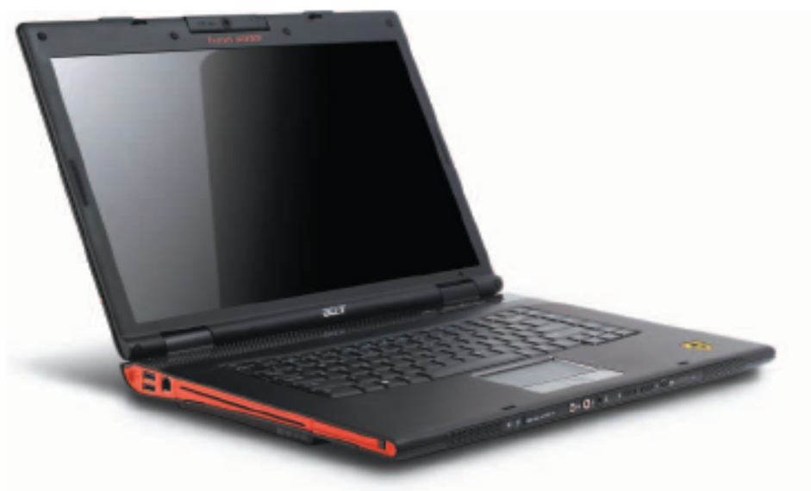
Investigating Types of Computers
Notebook computer
  also referred to as a laptop computer
  small
  lightweight
  portable
Microsoft Office 2007-Illustrated Introductory, Premium Video Edition

Slide 8
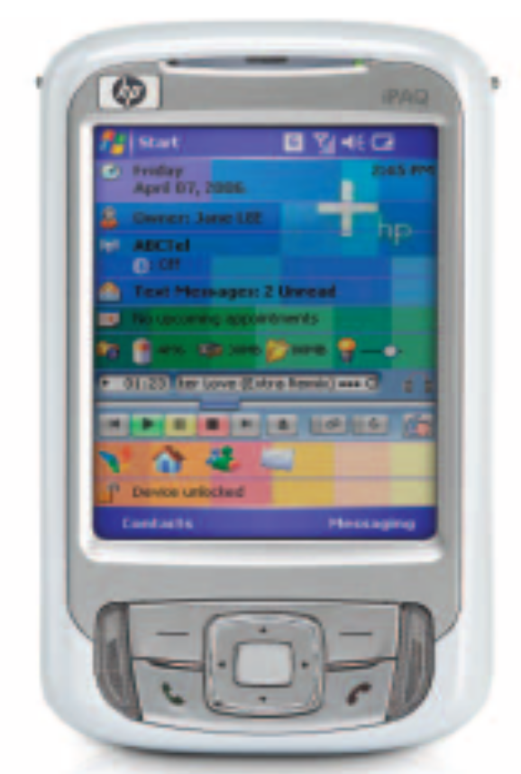
Investigating Types of Computers
PDAs
  Personal Digital Assistants
  generally used to maintain an electronic appointment book, address book, calculator, and notepad
Microsoft Office 2007-Illustrated Introductory, Premium Video Edition

Slide 9
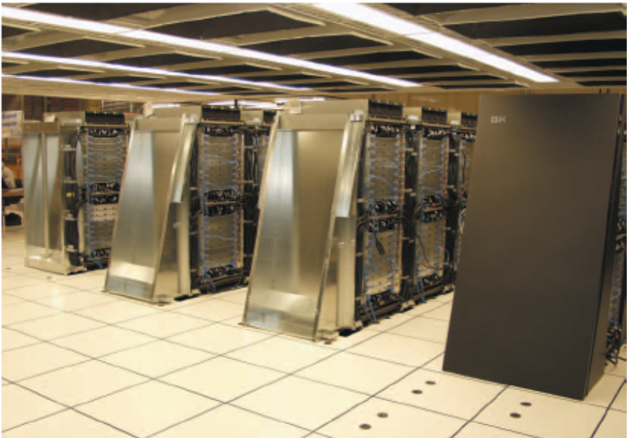
Investigating Types of Computers
Supercomputers are the largest and fastest of
computers, and can process an enormous
volume of data.
Microsoft Office 2007-Illustrated Introductory, Premium Video Edition

Slide 10
Examining Computer Systems
A computer system is made up of:
Hardware—the physical components
Software—the programs or lists of instructions
Microsoft Office 2007-Illustrated Introductory, Premium Video Edition

Slide 11
Examining Computer Systems
Architecture or configuration is the design of the computer.
  As in, what does the computer consist of?
Specifications are the technical details about each component.
  As in, how big is the monitor?
Microsoft Office 2007-Illustrated Introductory, Premium Video Edition

Slide 12
Examining Computer Systems
Data
  The words, numbers, figures, sounds, and graphics that describe people, events, things, and ideas
Processing
  Modifying data
Microsoft Office 2007-Illustrated Introductory, Premium Video Edition

Slide 13
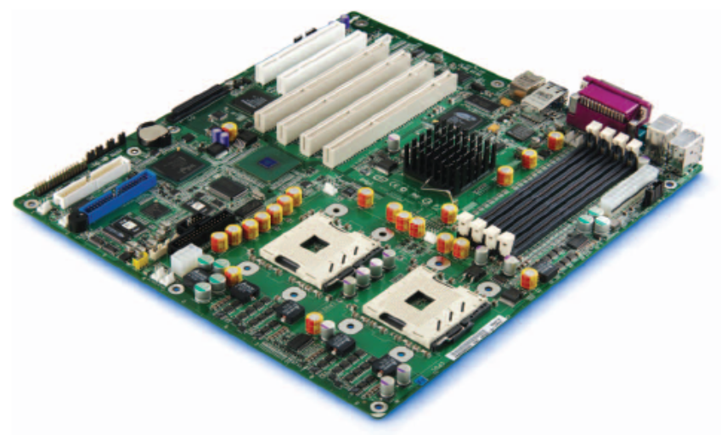
Examining Computer Systems
Motherboard
  where processing tasks occur
  located inside the computer
  the main electronic component of the computer
  contains the CPU
Microsoft Office 2007-Illustrated Introductory, Premium Video Edition

Slide 14
Examining Computer Systems
The data you type into the computer is called input.
The result of the computer processing your input is called output.
Peripheral devices accomplish the input, output, and storage functions.
Microsoft Office 2007-Illustrated Introductory, Premium Video Edition

Slide 15
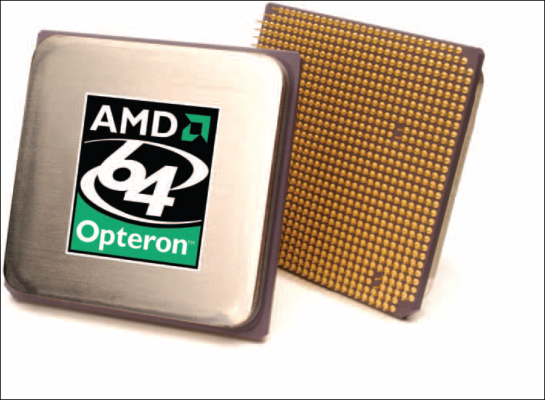
Examining Computer Systems
Microprocessor
  a silicon chip designed to manipulate data
  its speed is determined by:
    Clock speed
    Word size
    Processor type
Microsoft Office 2007-Illustrated Introductory, Premium Video Edition

Slide 16
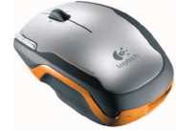
Examining Input Devices
Some input devices are:
Keyboard
Mouse
Trackball
Touch pad
Pointing stick
Scanner
Microphones
Cordless mouse
Microsoft Office 2007-Illustrated Introductory, Premium Video Edition

Slide 17
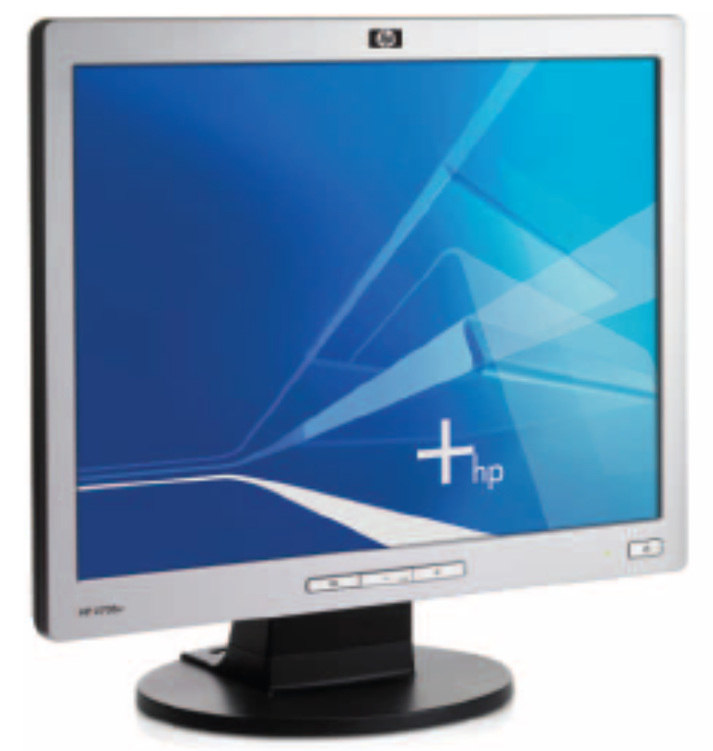
Examining Output Devices
Factors that influence
a monitor’s quality are:
Screen Size
Resolution
Dot Pitch
Microsoft Office 2007-Illustrated Introductory, Premium Video Edition

Slide 18
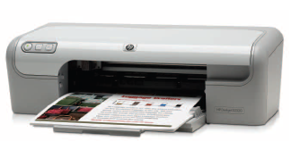
Examining Output Devices
Types of printers
Laser
Dot Matrix
Inkjet
Inkjet printer
Microsoft Office 2007-Illustrated Introductory, Premium Video Edition

Slide 19
Investigating Data Processing
Kilobyte (KB) = one thousand bytes
Megabyte (MB) = one million bytes
Gigabyte (GB) = one billion bytes
Terabyte (TB) = one trillion bytes
Microsoft Office 2007-Illustrated Introductory, Premium Video Edition

Slide 20

Understanding Storage Media
USB flash storage device (USB drive, flash drive)
  popular type of flash memory
  available in a wide range of sizes from 32 MB to 16 GB
  plug directly into the USB port of a personal computer
  are about the size of a pack of gum and often have a ring that you can attach to your key chain.
Microsoft Office 2007-Illustrated Introductory, Premium Video Edition

Slide 21
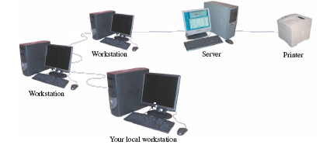
Learning about Networks
Workstation
Server
Printer
Workstation
Your local workstation
Network configuration
Microsoft Office 2007-Illustrated Introductory, Premium Video Edition

Slide 22
Learning about Networks
LAN (local area network)
  computers and peripherals located close to each other
WAN (wide area network)
  more than one LAN connected together
  the Internet is the largest example of a WAN
WLAN (wireless local area network)
  computers and peripherals that use high-frequency radio waves instead of wires to communicate and connect in a network
  Wi-Fi (wireless fidelity) describes WLANs connected using a standard radio frequency established by the Institute of Electrical and Electronics Engineers (IEEE)
Microsoft Office 2007-Illustrated Introductory, Premium Video Edition

Slide 23
Learning about Networks
PAN (personal area network)—a network that allows two or more devices located close to each other to communicate or to connect a device to the Internet
  infrared technology—uses infrared light waves to beam data from one device to another
  Bluetooth—uses short range radio waves to connect a device wirelessly to another device or to the Internet
WiMAX (Worldwide Interoperability for Microwave Access)
  allows computers to connect over many miles to a LAN
  a WiMAX tower sends signals to a WiMAX receiver built or plugged into a computer
Microsoft Office 2007-Illustrated Introductory, Premium Video Edition

Slide 24
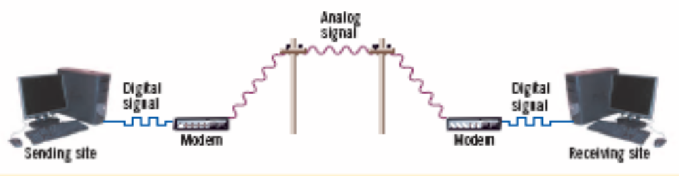
Learning about Networks
Analog signal
Digital signal
Digital signal
Modem
Modem
Sending site
Receiving site
Using modems to send and receive data
Microsoft Office 2007-Illustrated Introductory, Premium Video Edition

